Slide 1
Web scrapping using Power Query in Excel
by Gayatri Kotlo

Slide 2
What is Power Query and Power Pivot
Power Query (aka “Get & Transform”) allows you to:
Connect to data across a wide range of sources
Filter, shape, append and transform raw data for further analysis and modeling
Create stored procedures to automate your data prep
Power Pivot is great for modeling the data you've imported.
Use both to shape your data in Excel so you can explore and visualize it in PivotTables, Pivot Charts, and Power BI.

Slide 3
WHEN TO USE POWER QUERY & POWER PIVOT
Analyze more data than can fit into a worksheet
Create connections to databases or external sources
Blend data across multiple large tables
Automate the process of loading and shaping your data
Unleash the full business intelligence capabilities of Excel
Use Power Query and Power Pivot when you want to…

Slide 4
Now using Power Query lets do Web scrapping
For this I imported https://www.gunviolencearchive.org/reports/mass-shooting?page=2
Where its gives all the mass shootings happened in Mass in 2022.

Slide 5
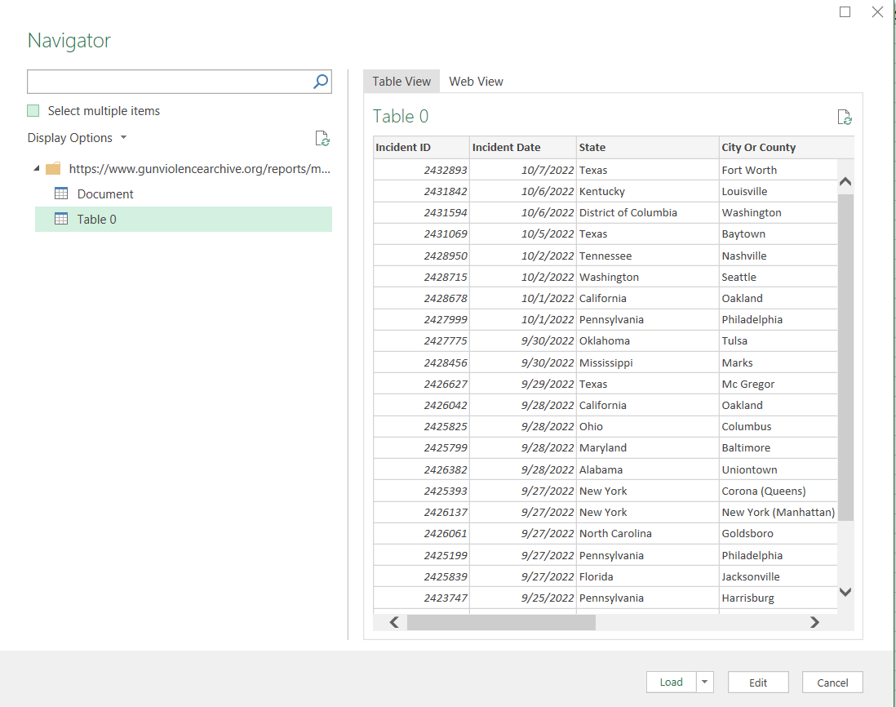
Lets Begin
Go to DATA> NEW QUERY> FROM OTHER >FROM WEB
Paste the link above and the window pops up stating

Slide 6
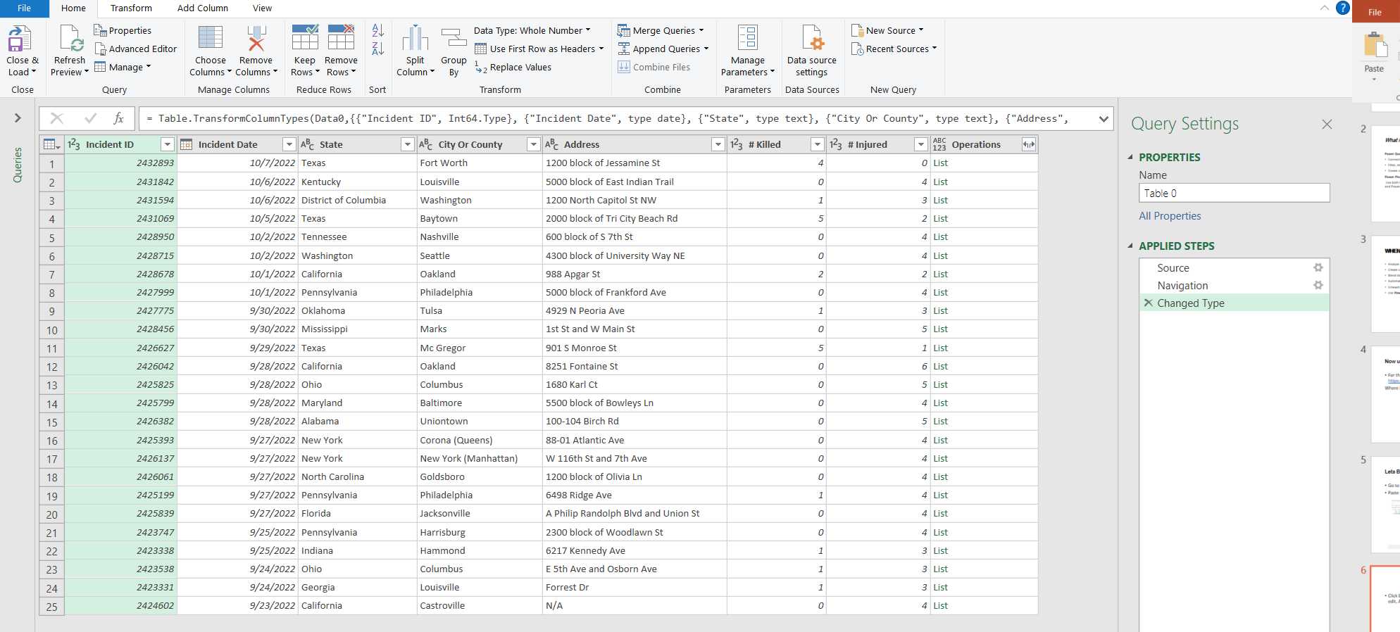
Click Edit and this take you to the power query editor where you can edit, Analyze and change the data as you want.

Slide 7
Firstly I have change the Table name to Mass shootings in 2022.
Checked all the datatypes respective of all the column's
Checked if there are any missing values
Checked if any column name has to be replaced or dropped.
Then finally closed and saved.

Slide 8
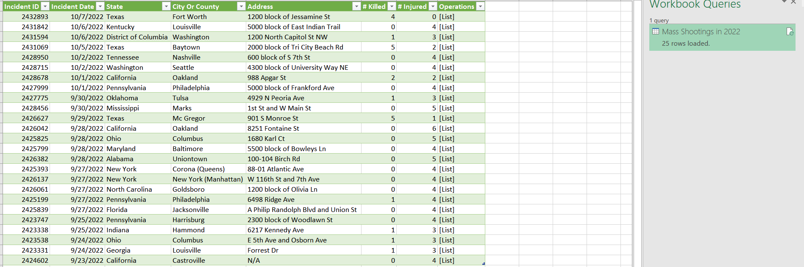
Excel then takes you to this clean and formatted Table

Slide 9
Analysis Part
Inserting the Pivot Table from Insert Tab and Performing the analysis.

Slide 10
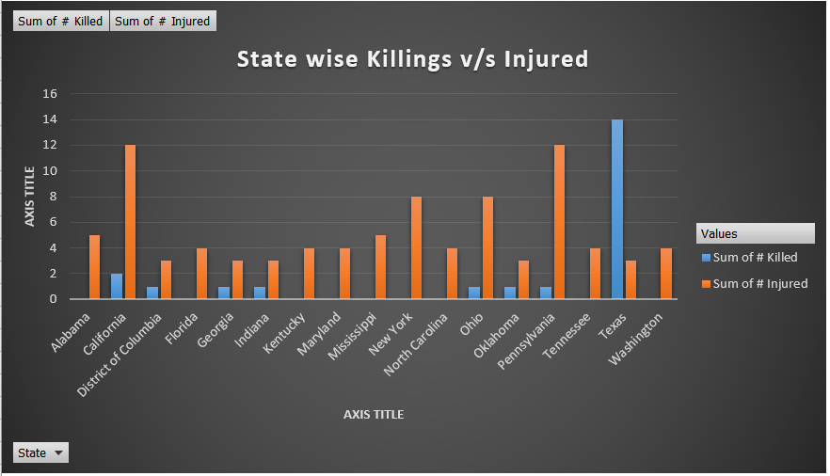
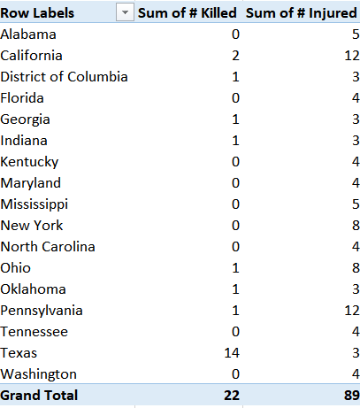
State Analysis

Slide 11
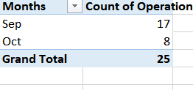
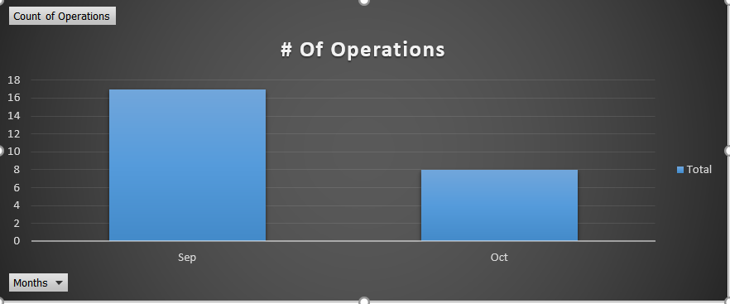
No of Operations

Slide 12
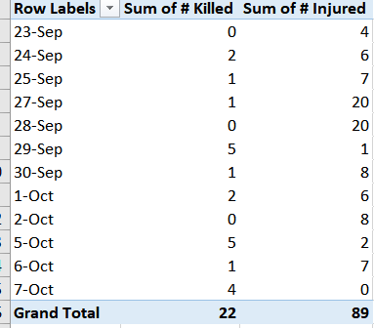
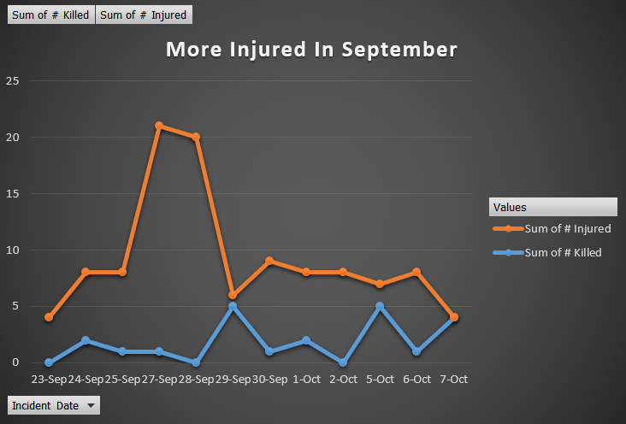
Injured v/s Killed

Slide 13
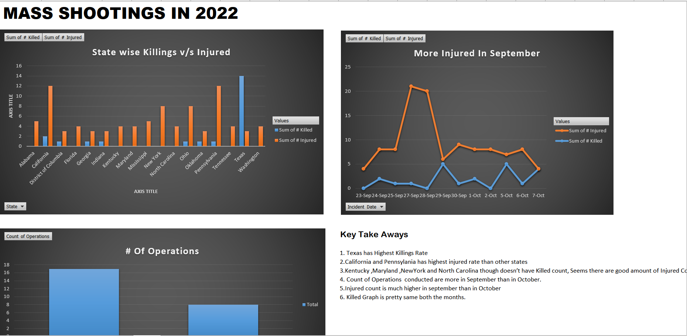
Final Dashboard

Slide 14
Gun Violence Must Stop. Here's What We Can Do to Prevent More Deaths
Sensible gun laws: Reduce easy access to dangerous weapons.
Establish a culture of gun safety.
Support gun violence research: Ensure that the Centers for Disease Control and Prevention (CDC) and others have the resources to study this issue and provide science-based guidance.
Health system: Establish a comprehensive health system in which violence prevention is a health system responsibility and imperative.
Invest in communities to promote resilience and mental health and wellbeing.

Slide 15


